Slide 1
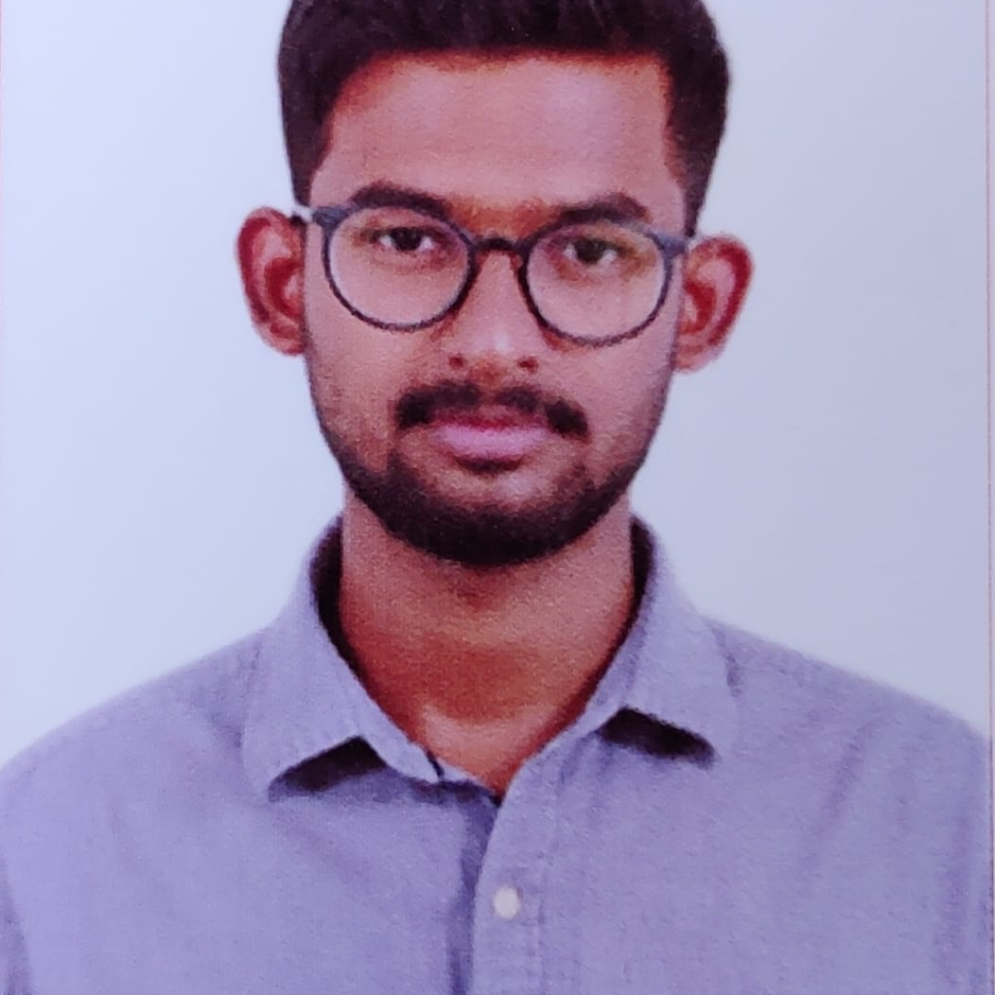



Y S JEEVAN SAI REDDY
Bachelor of Engineering
Electronics and Communication Engineering: 2018 - 2022
Skills Java 8
Spring Boot
Spring MVC
JPA CRUD
Rabbit MQ
Docker
AWS
MERN Stack
ReactJS
MongoDB
Agile
Database
MongoDB No Sql Basics
My SQL RDS Basics
Web Technologies
HTML5
CSS3
Javascript
AddOns
Github
Maven
Postman
Additional Details
Excellent Communication Skills
Time management
Analyst/Software Engineer
BANGALORE
JEEVAN-SAI-REDDY.Y-S@CAPGEMINI.COM
+91 9849045596
A4
Full Stack Developer
Software Engineer who is Strong in design and integration with intuitive problem-solving skills. Passionate about implementing and launching new projects.
Hands on experience in creating microservices with Spring Boot, Spring Security, Spring Cloud API Gateway, Eureka server.
Has working knowledge on ReactJS(Hooks, redux)and Java Microservice Development using Spring framework on an intermediate level.
E-Commerce Shopping Cart Application
Completed end to end case study of Shopping Cart Application along with JWT authentication, Swagger and payment testing, responsive UI with ReactJs.
Student Management System
Developed Student Management System using Spring Boot, MySQL and testing all api through postman along with responsive UI with HTML, CSS.
Check out my work on GitHub & Video Profile

